Slide 1
TUTORIALS OF MAKING COVID-19 DATA VISUALIZATION
Creafted By : Aurora Rahyu Fasya

Slide 2

Profile
Summary I have experience in the field of Economics and Business for 3 years in the field of Marketing and Banking. Experienced in campus organizations, namely the Management Study Program Student Association for 3 years. My background has expertise in Marketing. Email : Aurorarahyu23@gmail.com Linkedin : http://linkedin.com/in/aurora-rahyu-fasya-6abb89204
Bio
Aurora

Slide 3
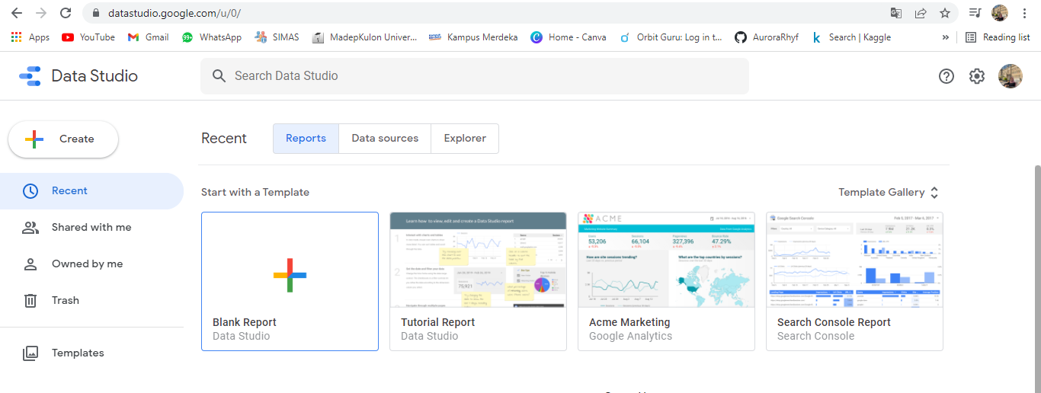
Step 1
Visit https://datastutdio.google.com
Login or sign up with your Gmail account
Then create new report / blank report

Slide 4
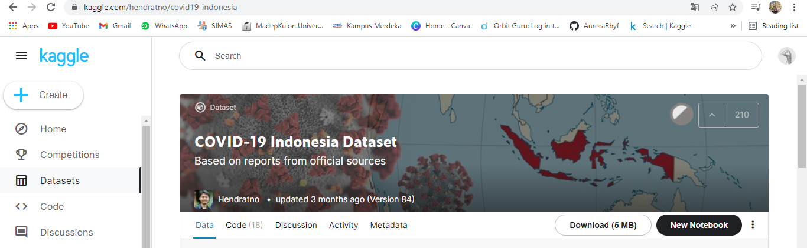
Step 2
Download the dataset from Kaggle

Slide 5
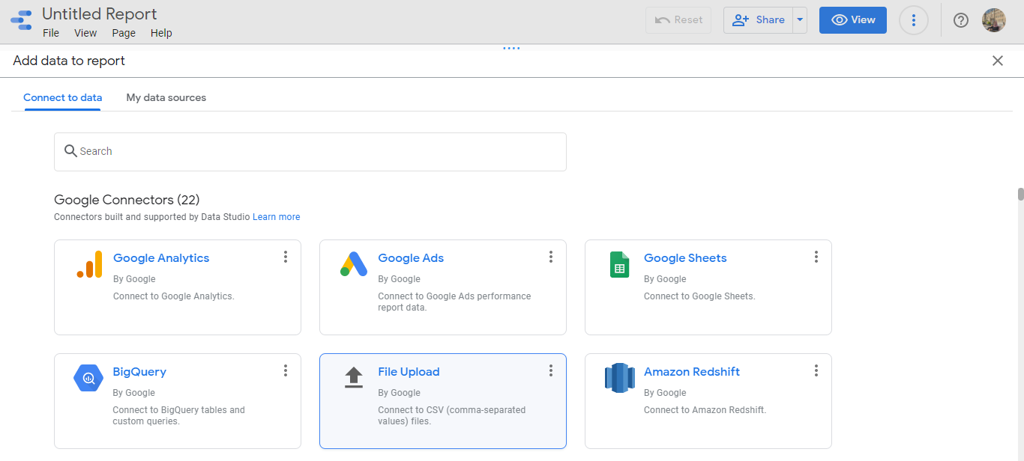
Step 3
Upload/add the dataset to Google Data Studio

Slide 6
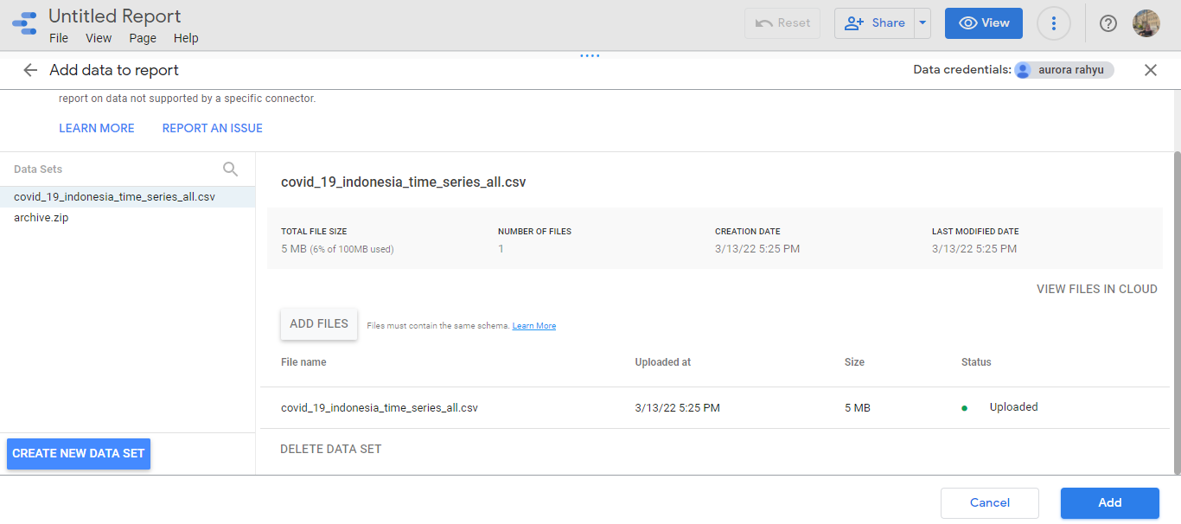
Step 4
Wait until the dataset is already uploaded
!
!
!
!
1st Period
2nd Period
3rd Period
4th Period

Slide 7
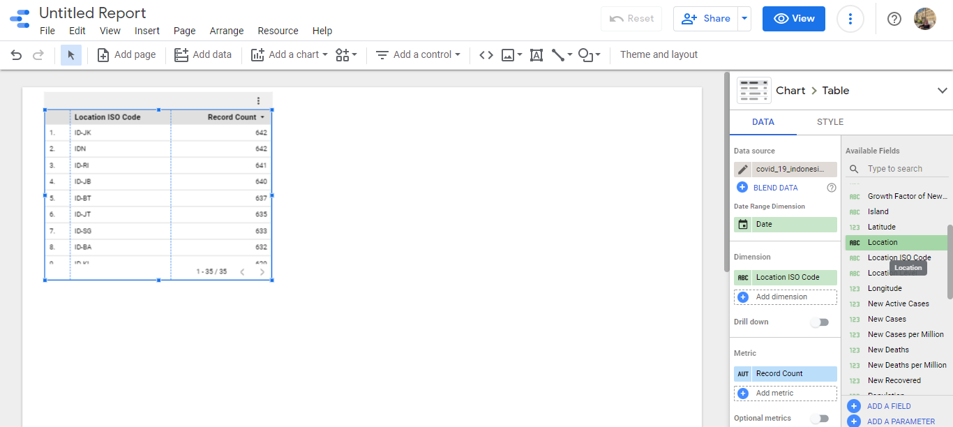
Step 5
Data uploaded

Slide 8
Step 6
Add Location to Dimension

Slide 9
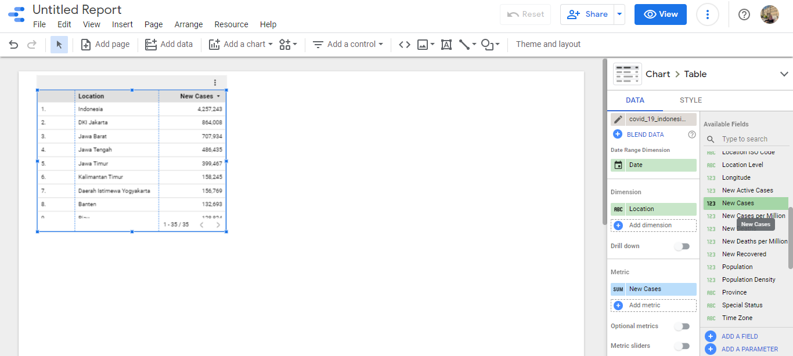
Step 7
100
0
Then, add New Cases to Metric and remove Record Count from Metric

Slide 10
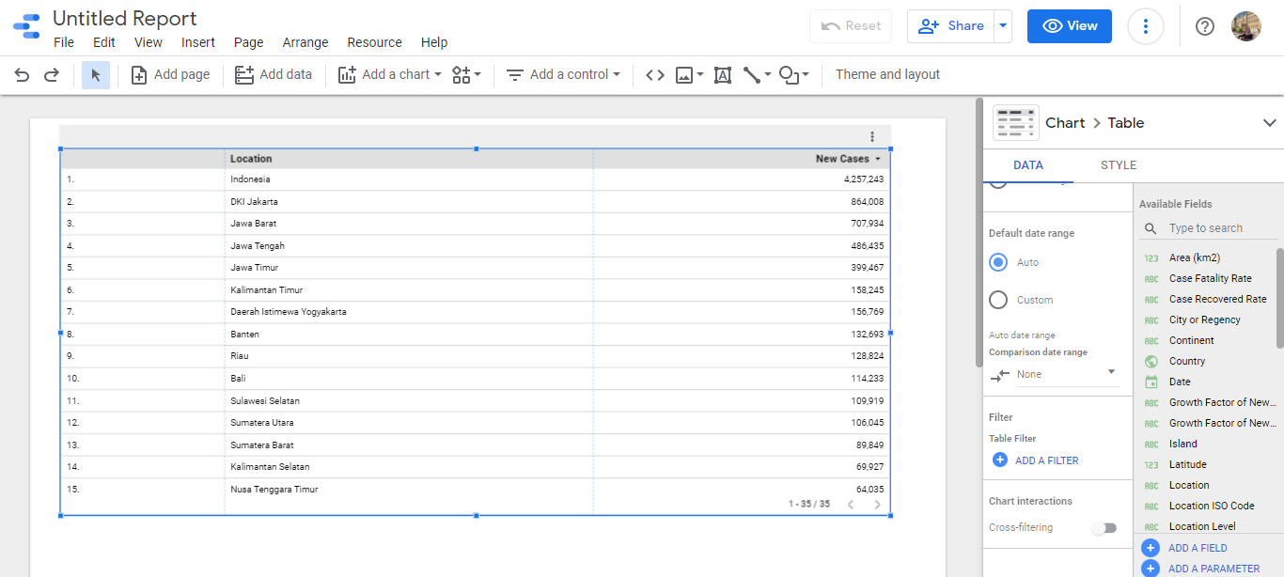
Step 8
We want to remove Indonesia from the lists bcs we just need to show Province in "Location“ How?
Just scroll down & click the “Add A Filter” menu

Slide 11
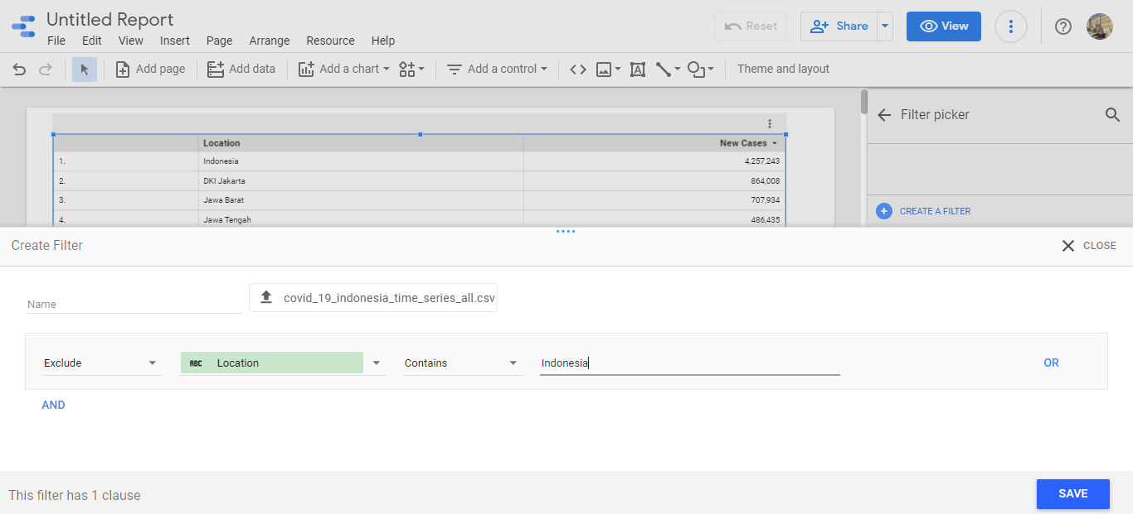
Step 9
Then, choose Exlude – Location – Contains – indonesia to remove Indonesia from the lists

Slide 12

Step 10
Already removed

Slide 13
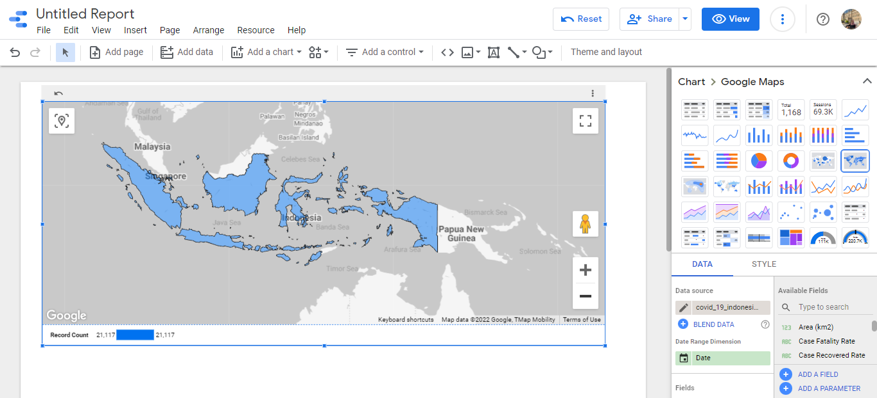
Step 11
Then, change the chart style from “Table” to “Google Maps”

Slide 14
Step 12
100
75
50
25
0
Clik “Edit Data Source”

Slide 15
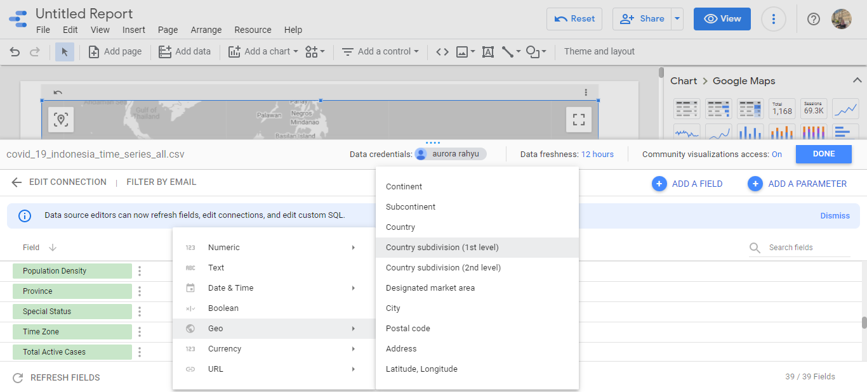
Step 13
Then, scroll to dimension “province” and change type from “Text” to “Geo” and choose “Country Subdivision (1st Level)

Slide 16
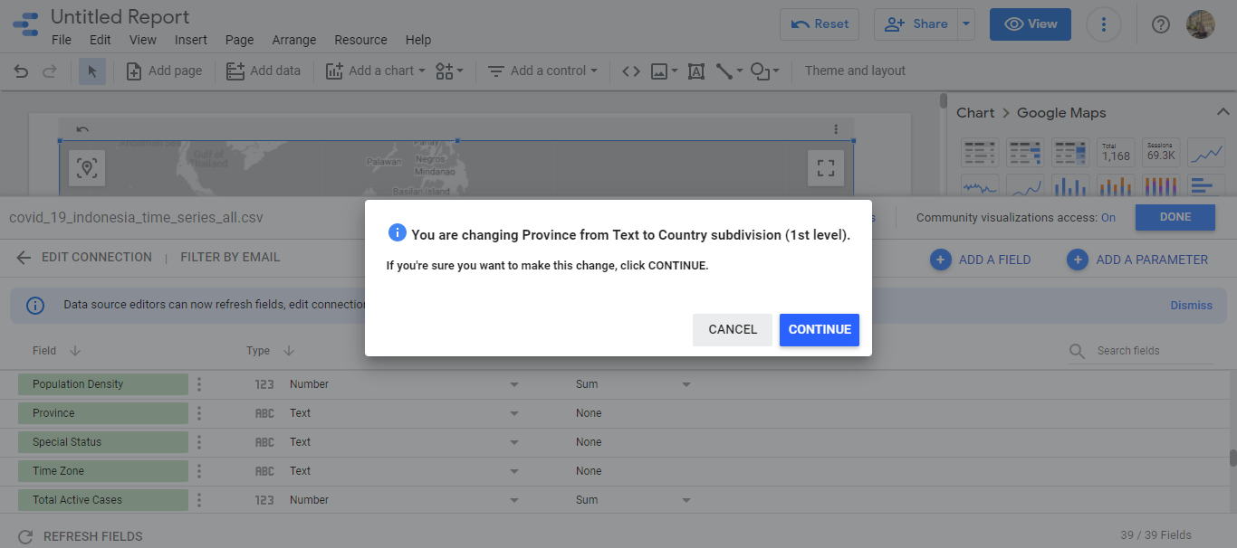
Step 14
Click Continue

Slide 17
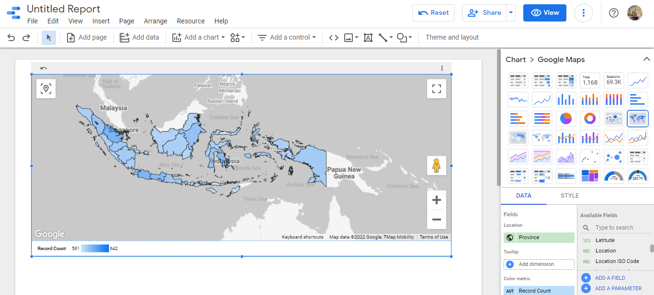
Step 15
Add / drag “Province” to Location,
and remove “ Country” from Location

Slide 18
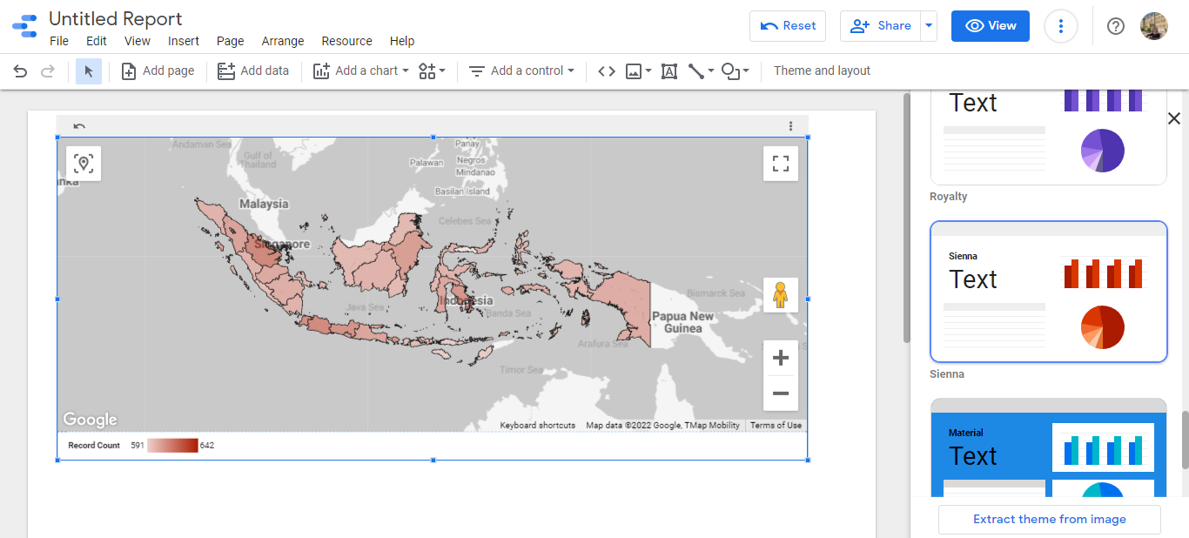
Step 16
50
25
-25
-50
Its already finished. We can change the chart style to Dark Mode

Slide 19
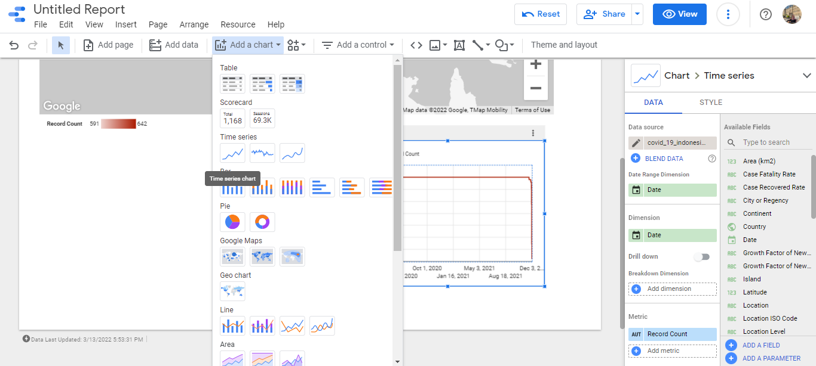
Step 17
70
Add a chart “time series” to visualize covid-19 case report based on the time

Slide 20
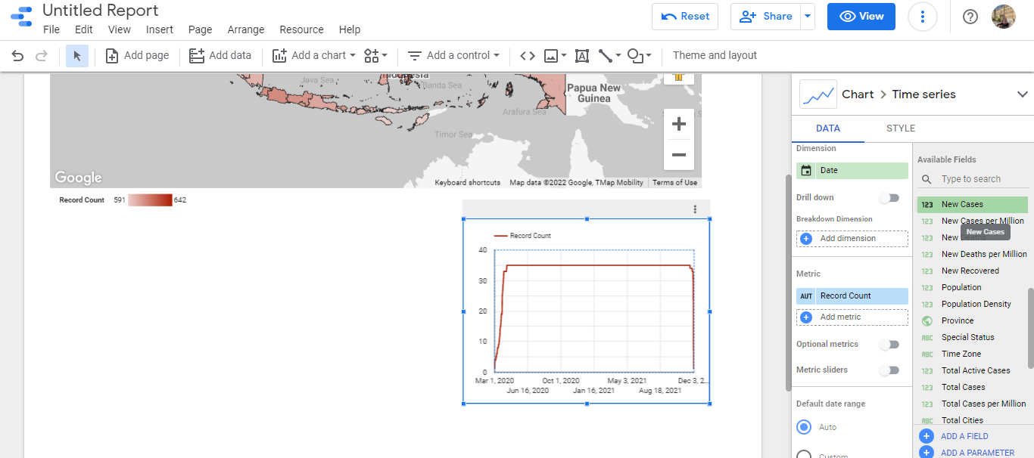
Step 18
50
25
0
-25
-50
Change “Record Count” to “New Cases” to get the New Cases data of Covid-19

Slide 21
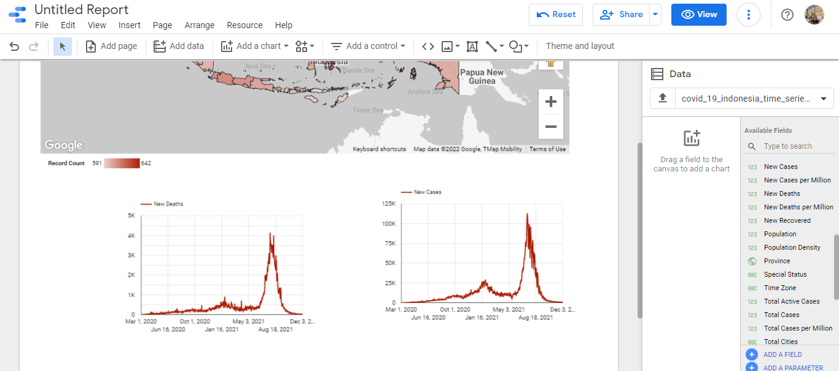
Step 20
Then, change “ new cases” to “new deaths” to get the new deadths data of covid-19

Slide 22
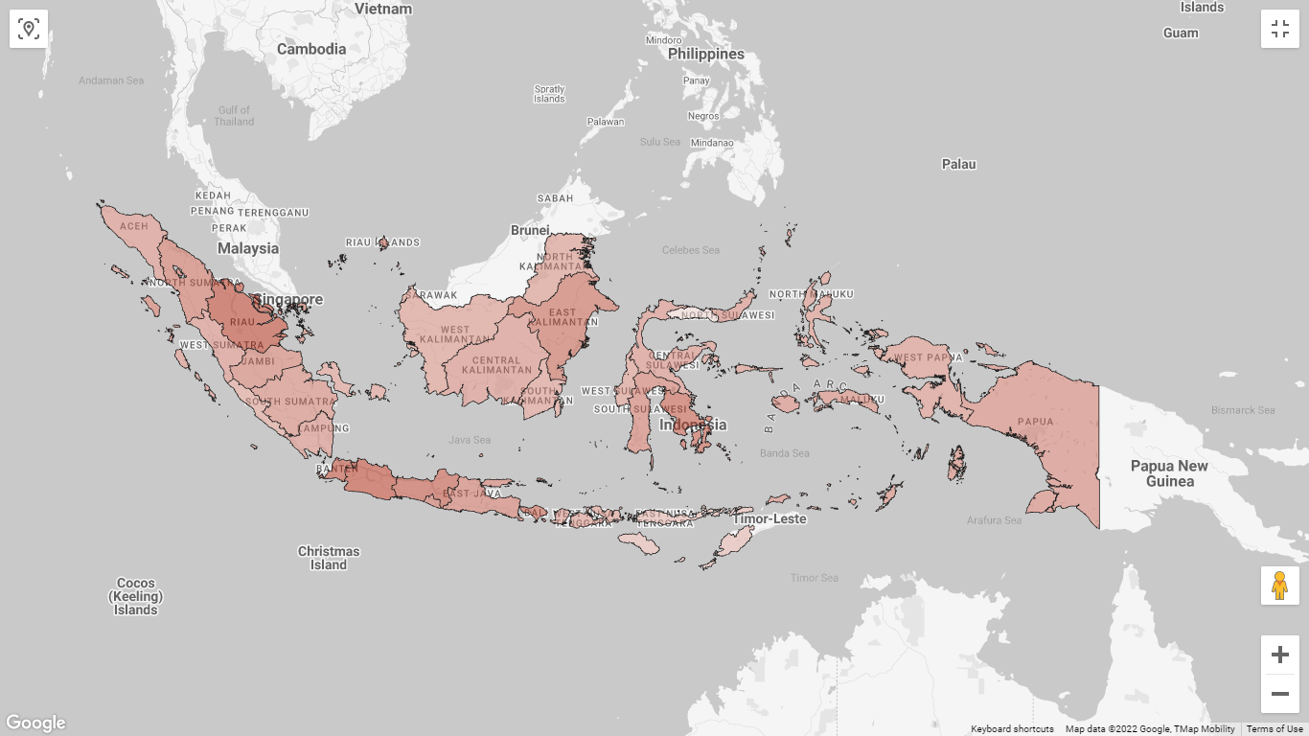
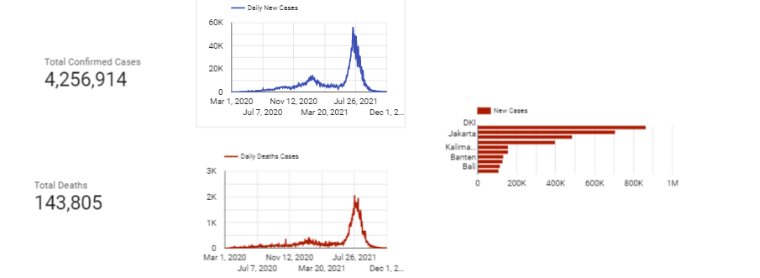
Finished

